Slide 1
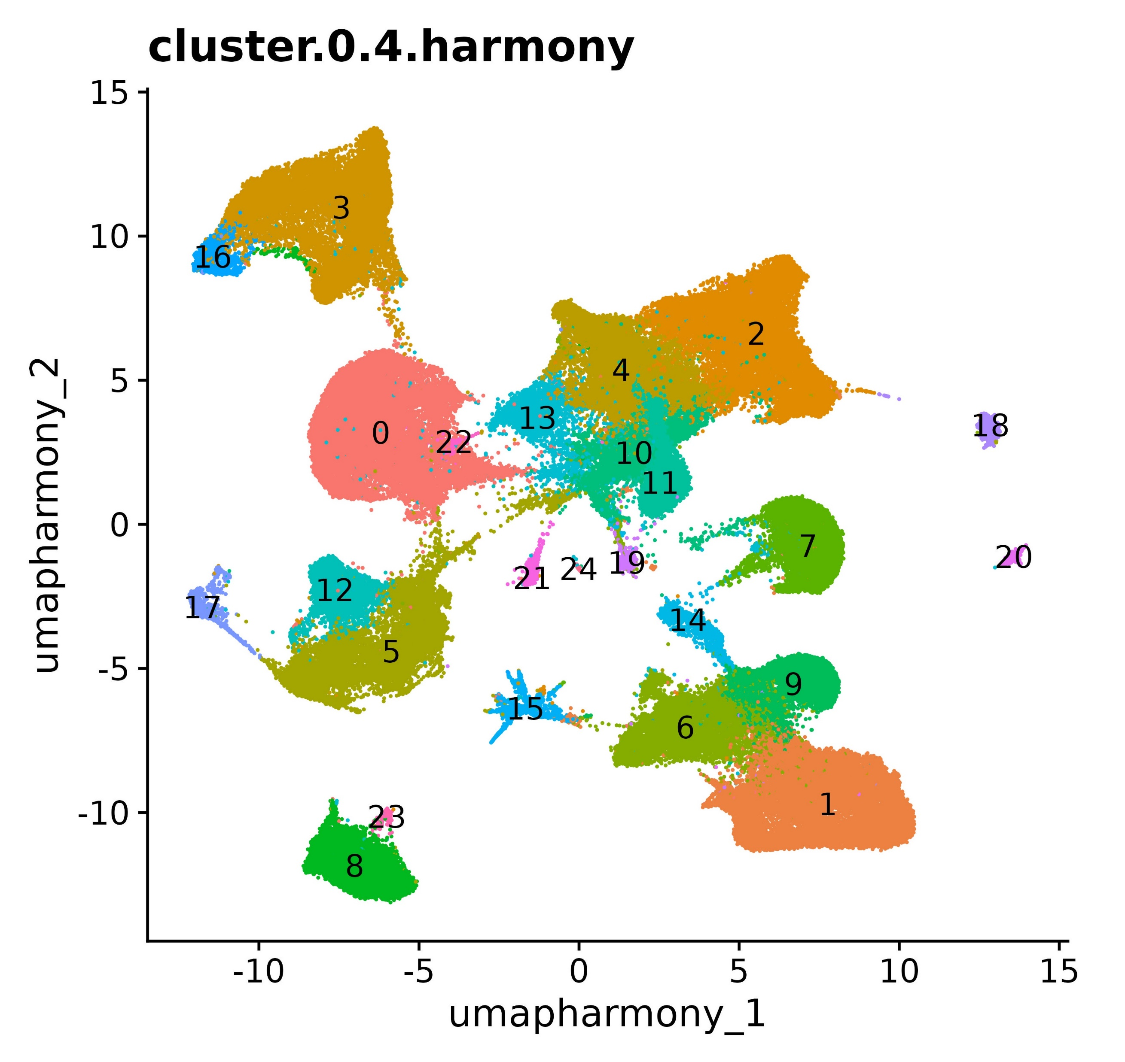
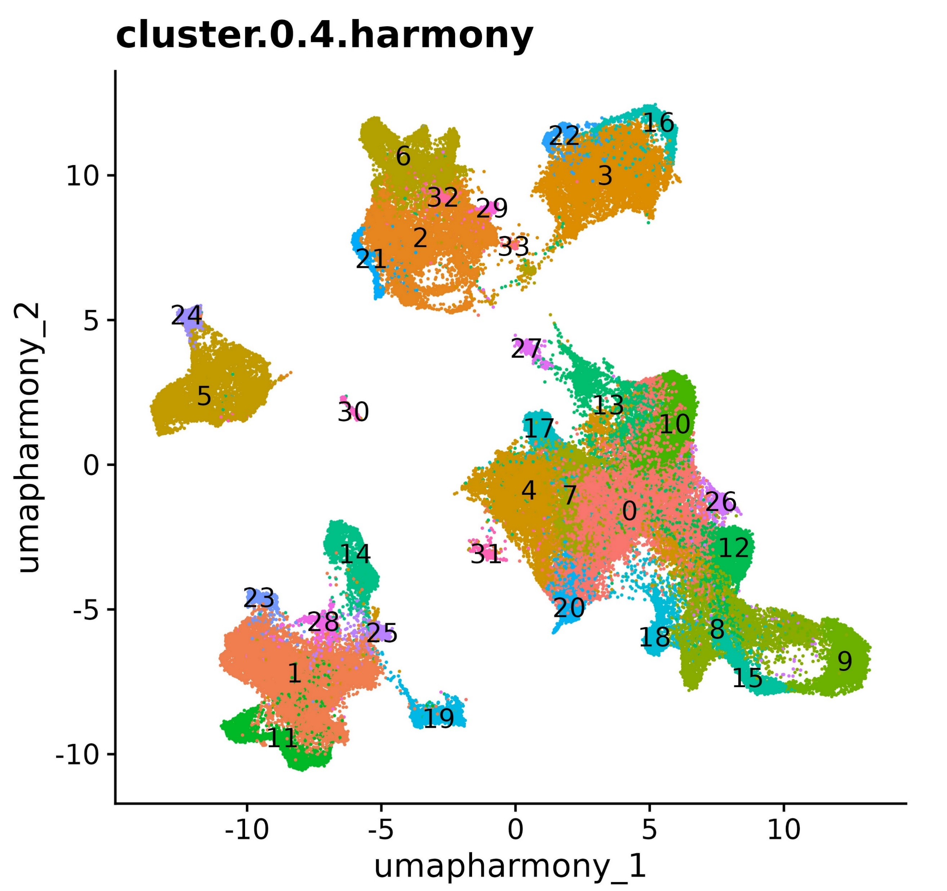
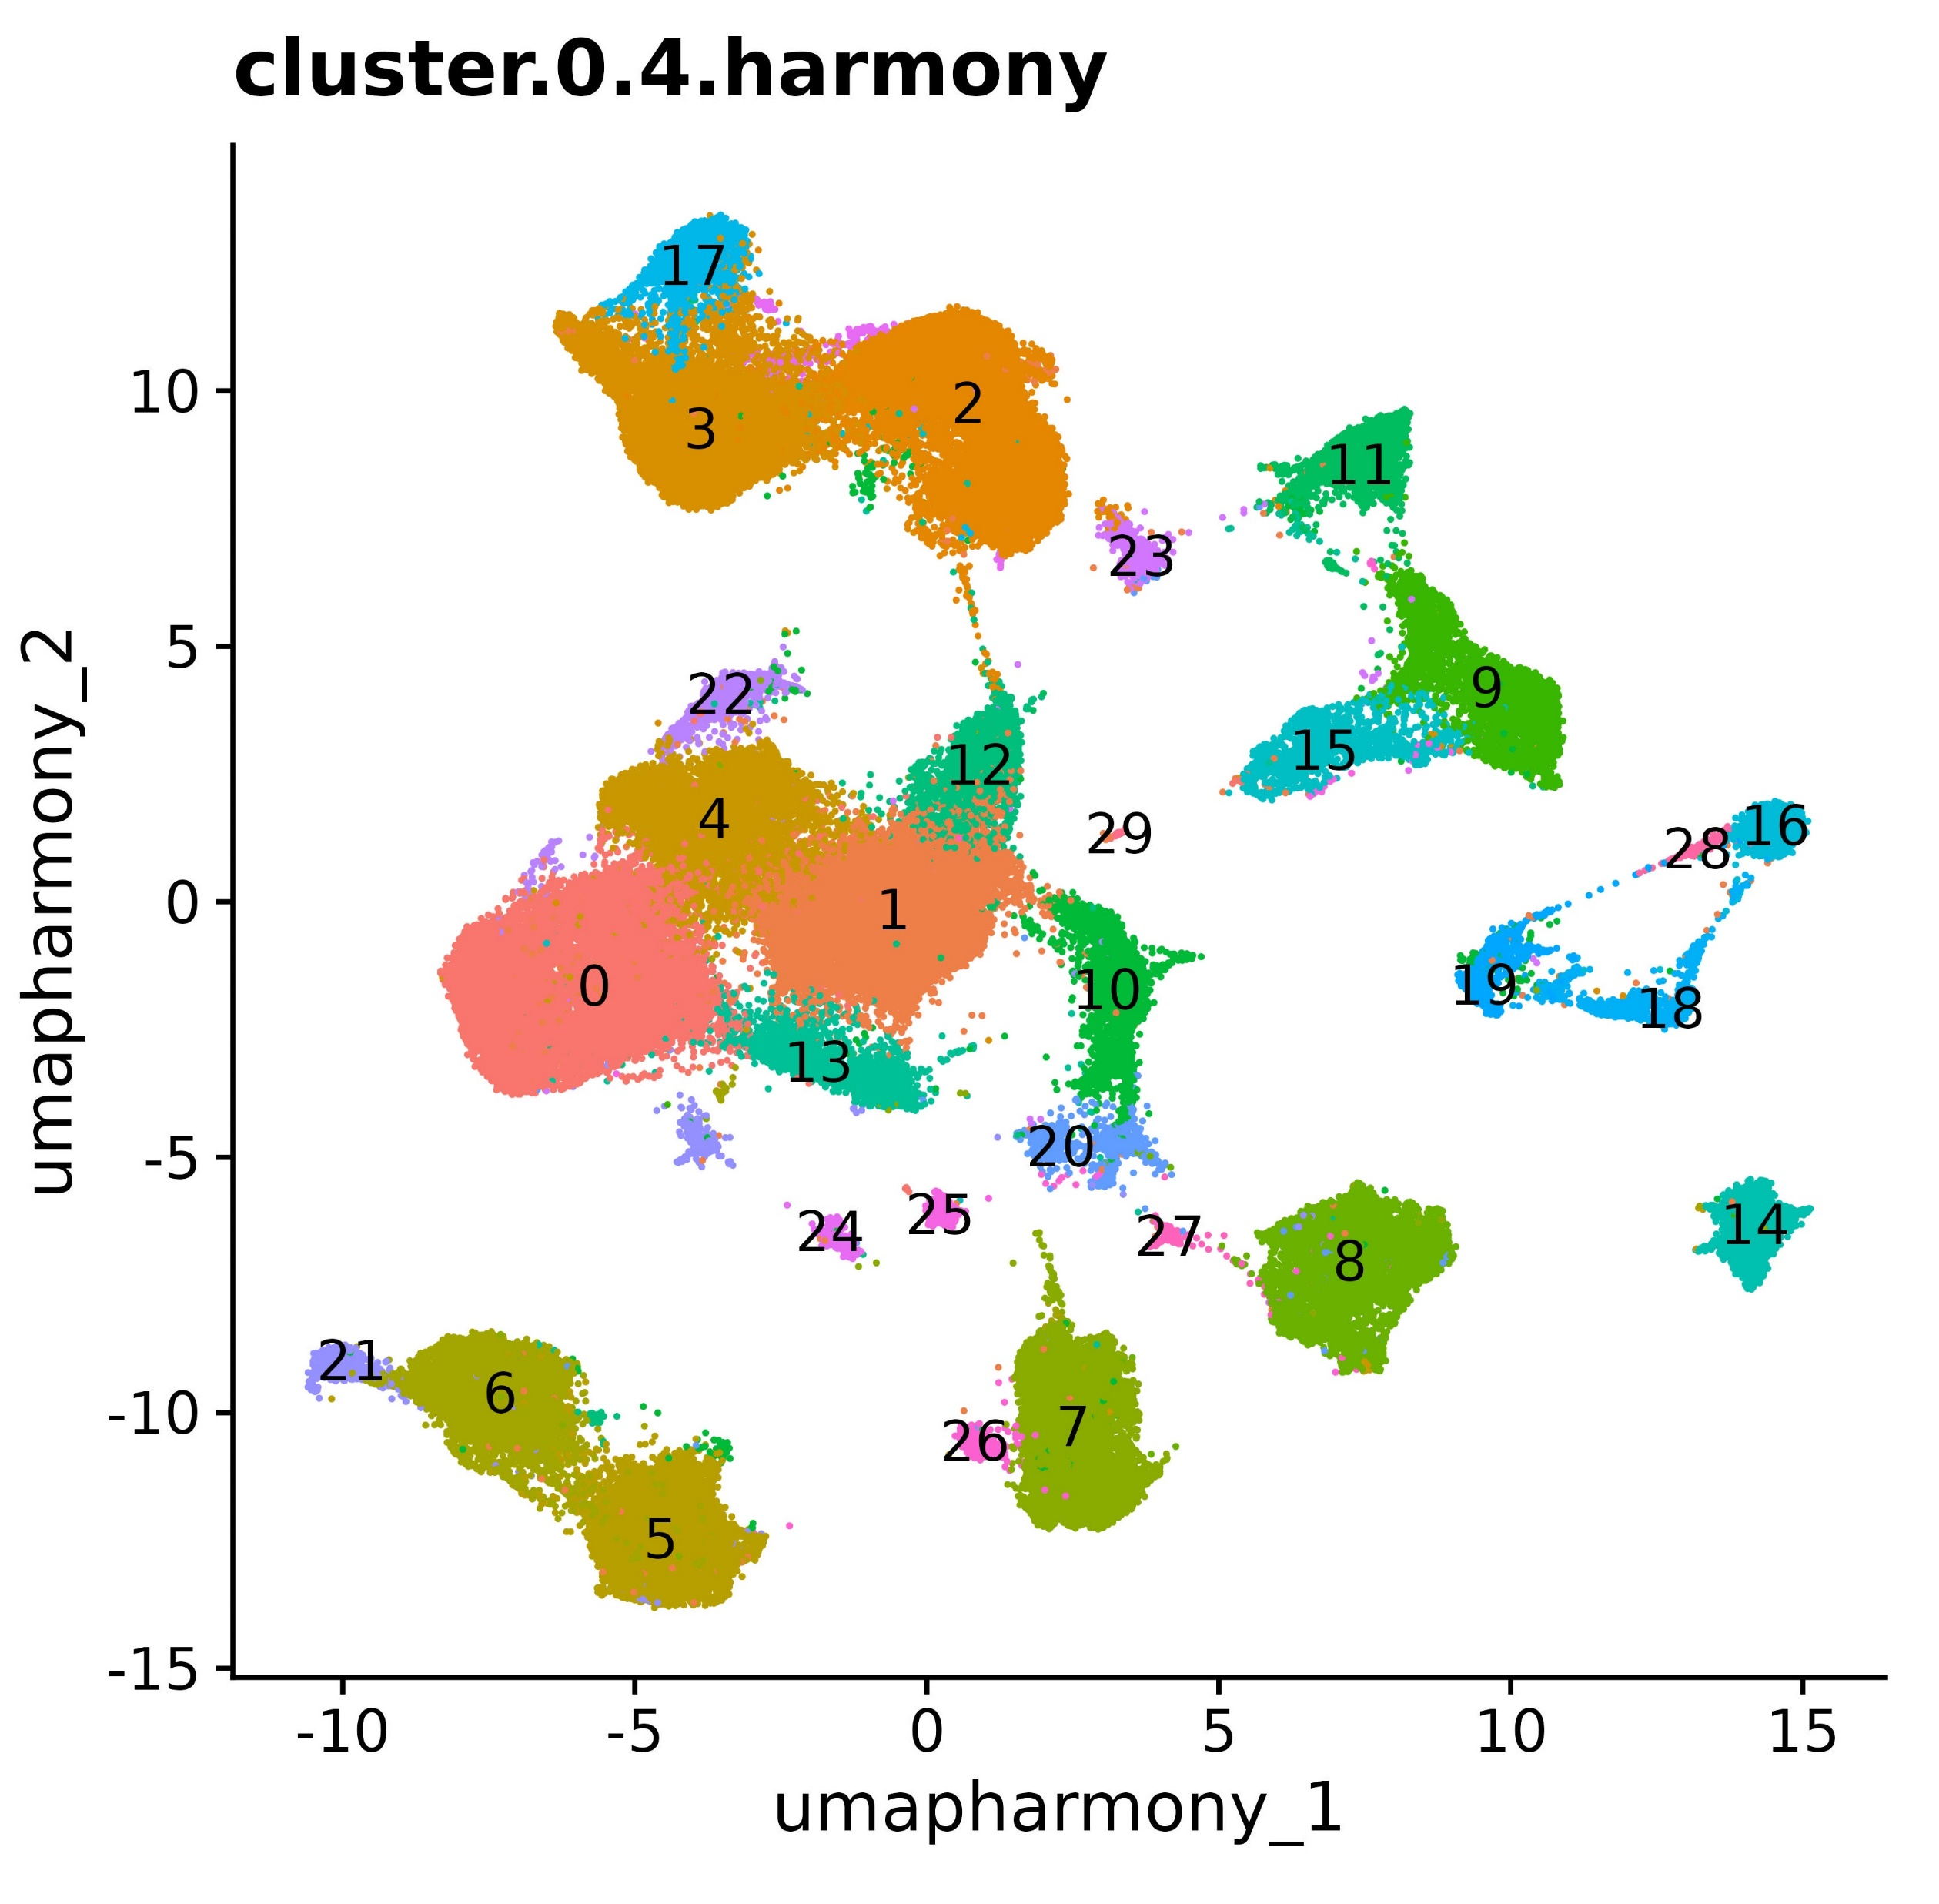
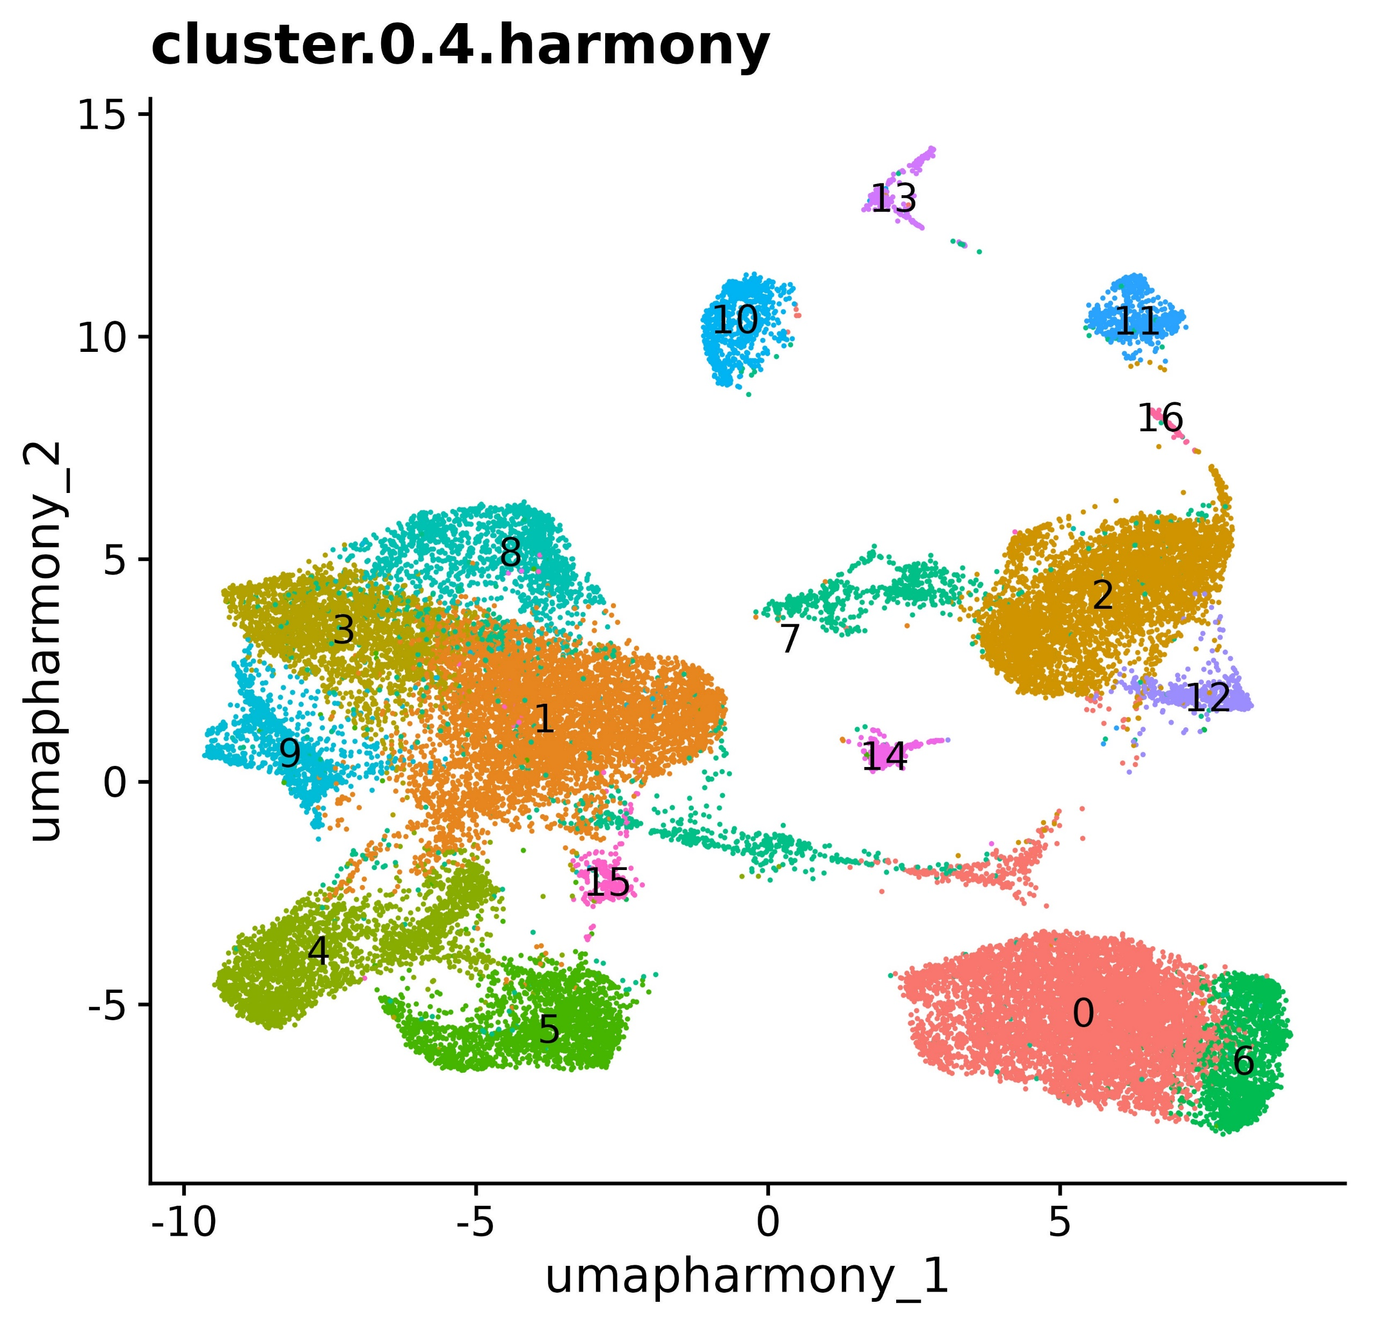
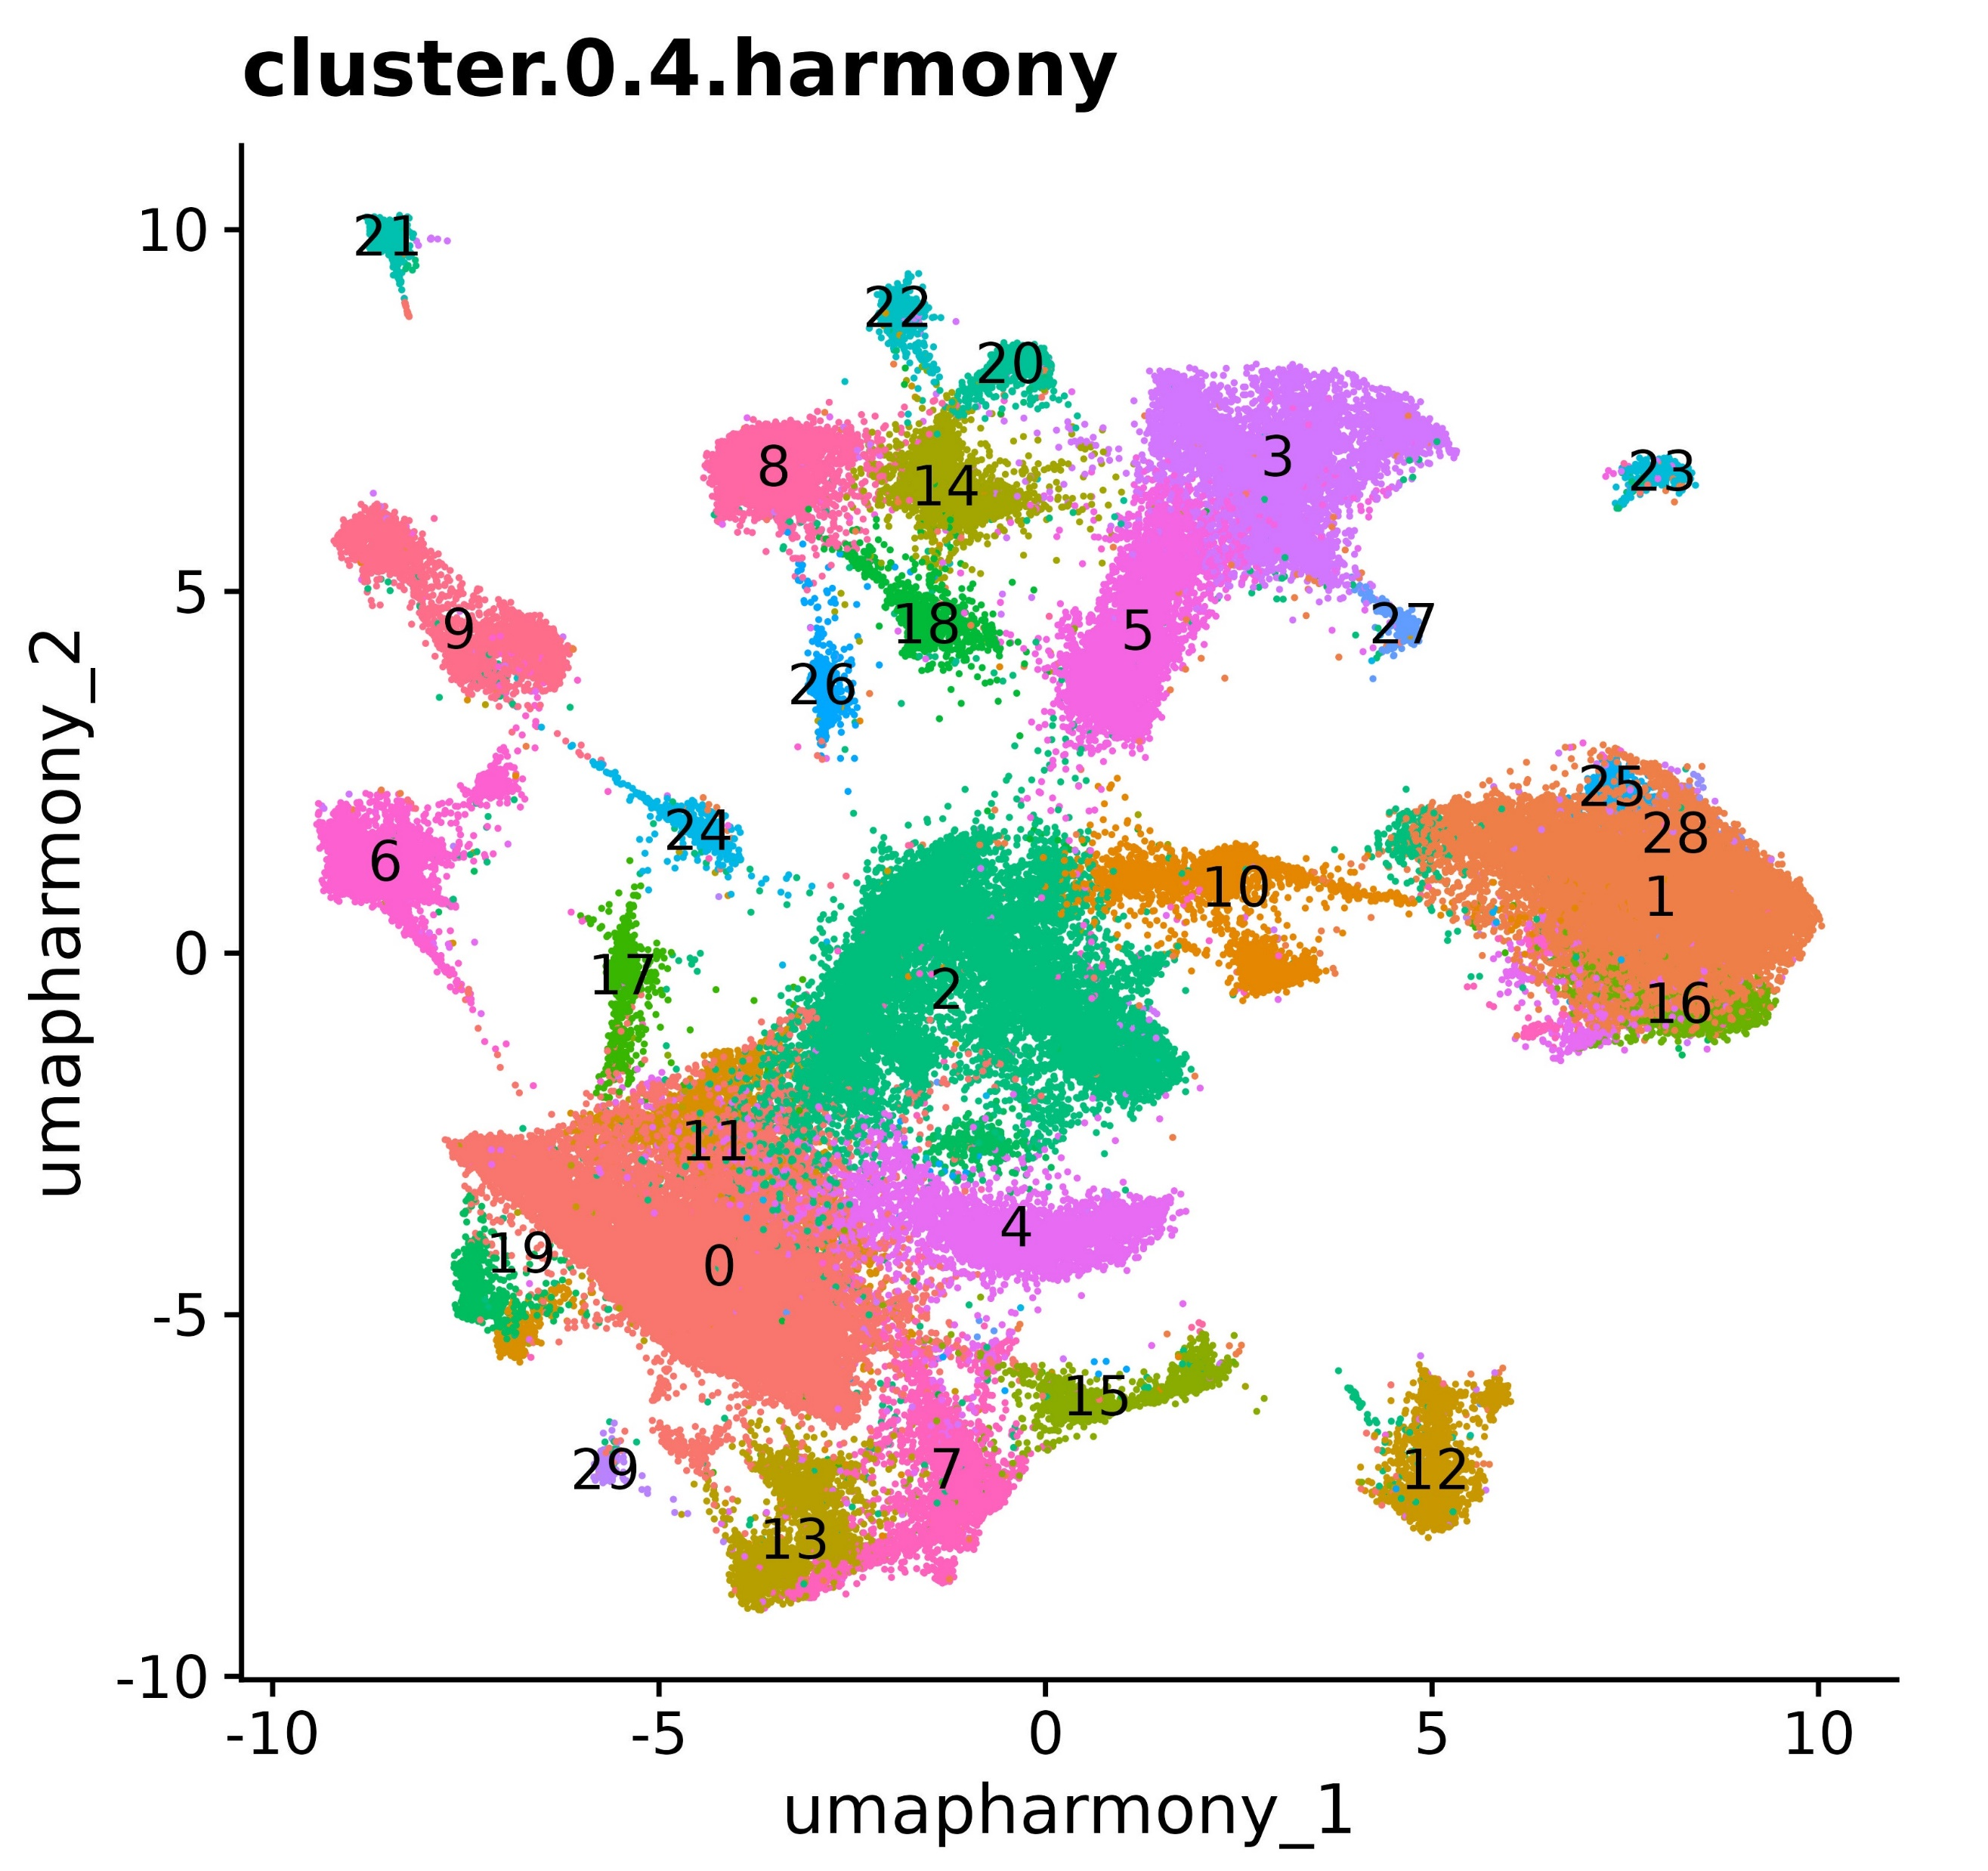
C57B6
NOTE: Initially, we grouped clusters 1,8,9 together in Jinfen dataset. Later, it was found that 9 is
Different from 1,8. But this error doesn’t mean we lost good markers because all genes from
these 3 clusters will be combined and then interesected with other datasets.
Rag
Chen
 | Jinfen | C57B6 | Rag | Chen | Simon
Epithelial_1 |  | 2 | 8,9,12,15,17,18,26 | 0,13,23,25,1,4,22 | 0,13
Epithelial_2 | 10 | 4 | 0
Lymp. endo | 13 (mix) | 18 | 30
Endothelial | 13 (mix) | 7 | 5,24 | 5,6,21 | 12
Granulocytes |  |  |  | 14 | 21
Plasma cells |  | 23 |  | 28
 | 3 |  |  | 12
B cells | 14 | 8 |  | 11
T cells | 4,15 | 3 |  | 2,3,17 | 6
NK Cells | 1,8,9 | 16
Macrophages | 2,12 | 5,12 | 2,6 | 9
DCs | 11,16 | 17
Mast Cells | 0,6 | 0,22 | 3 | 15
Myofibroblasts |  | 14 | 19 | 7,26 | 3,5,22
Fibroblasts_1 |  | 6,9 | 14
Fibroblast_2 | 13 (mix) | 1 | 1 | 8
Fibroblast_3 |  |  | 28 |  | 8,14
Jinfen
Simon

Slide 2
C57B6
Rag
Chen
 | Jinfen | C57B6 | Rag | Chen | Simon
Myofibroblasts |  | 8(14) | 7(19) | 7(7),19(26) | 2(3,5,27) 5(8,14,20),11(22)
Fibroblasts | 11(13) | 4(1,6,9),12(19) | 4(1,11,23,25,28),6(14) | 8(8) | 9(18)
Lymp. endo |  | 11(18) | 8(30)
Endothelial |  | 6(7) | 3(5,24) | 15(21),5(5),6(6) | 8(12)
Macrophages | 6(2), 10(12) | 3(5,12) | 5(2,6,21,29,32,33) | 3(9,15) | 7()
Epithelial |  | 5(2,4,10,11,13) | 1(0,4,7,8,9,10,12,13,15,17,18,20,26,27,31) | 1(0,1,4,12,13,22),16(23), 18(25) | 1(), 4()
Monocytes | 1(0,6) | 1(0,22) | 2(3,16,22)
 |  |  |  | 11() | 10()
B cells | 12(14) | 7(8) |  | 10(11)
NK/T cells | 3(4),13() | 2(3,16) |  | 2(),17() | 6(6)
DCs | 14(16), 9() | 10(17)
Jinfen
Simon

